Slide 1
Cryptovisor: A Cryptocurrency Advisor Tool
Matthew Baldree
Paul Widhalm
Brandon Hill
Matteo Ortisi
Notes:
Good afternoon, my name is _____ and our presentation is on Cryptovisor, a tool that provides trading recommendations for cryptocurrency using a stochastic gradient boost classifier trained from a model labeled by technical momentum indicators.

Slide 2
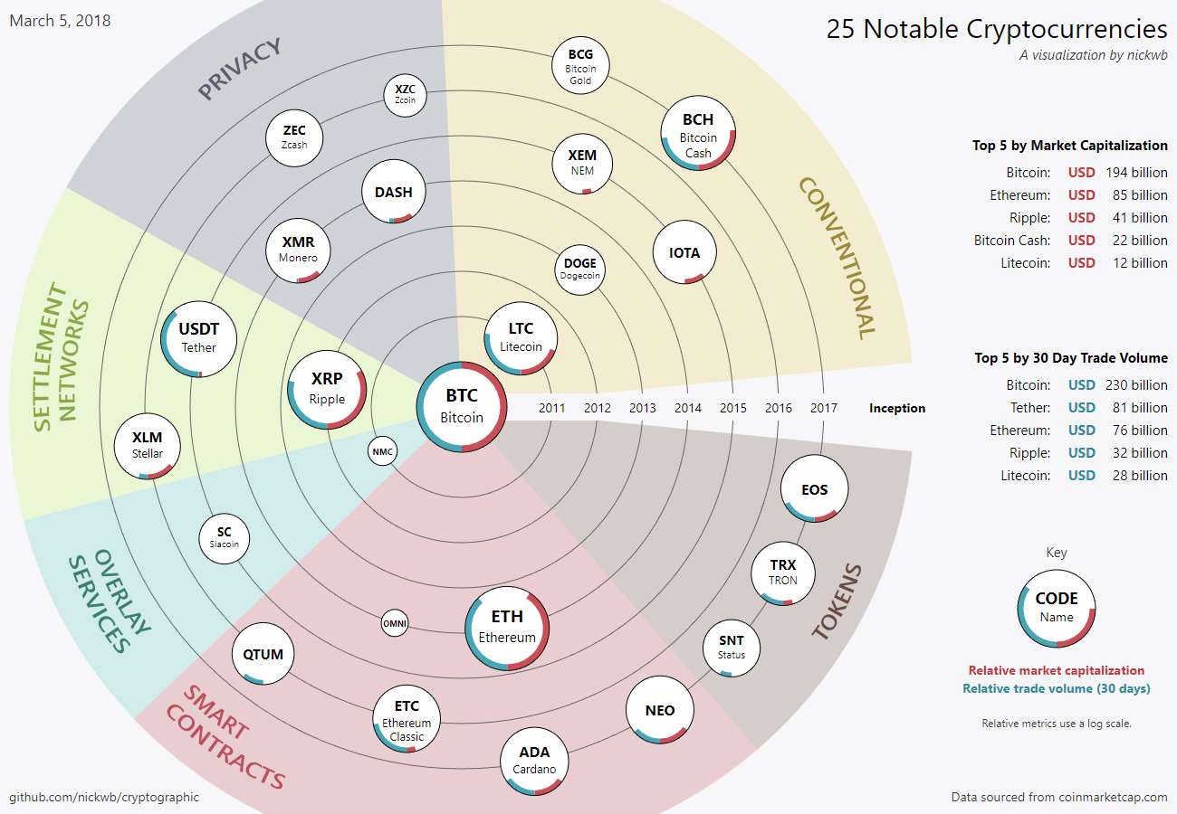
Cryptocurrencies (Crypto)
Notes:
Cryptocurrency is an asset designed to be used as digital currency.
The asset is a chain of digital signatures that exist in binary format secured by cryptography with the right to use.
There are two kinds of cryptos today: coin and token, totaling over 1,500 cryptos.
All cryptos are not the same. Some are focused on different problems on top of currency concerns such as privacy, smart contracts, tokens.

Slide 3
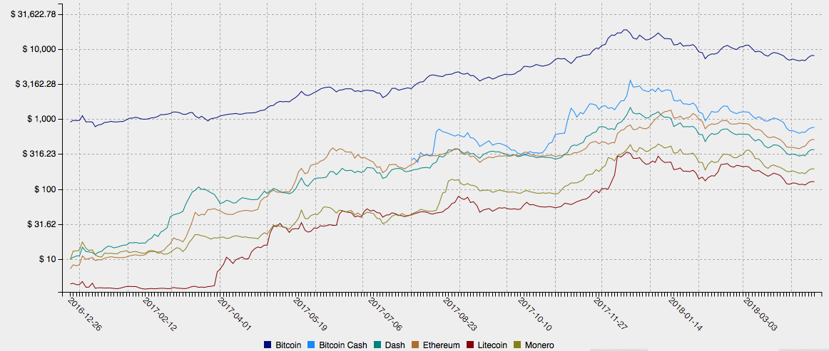
Market
$19,000
Notes:
Many of the cryptos are traded on many of the 5,400 exchanges totaling in 2017 a market capitalization of $821B at its all time high.
This graph shows the price over the last year of the major cryptos on a log scale.
You can see that Bitcoin rose $19,000 in a one year time period.
Who wouldn’t be interested in that return?

Slide 4
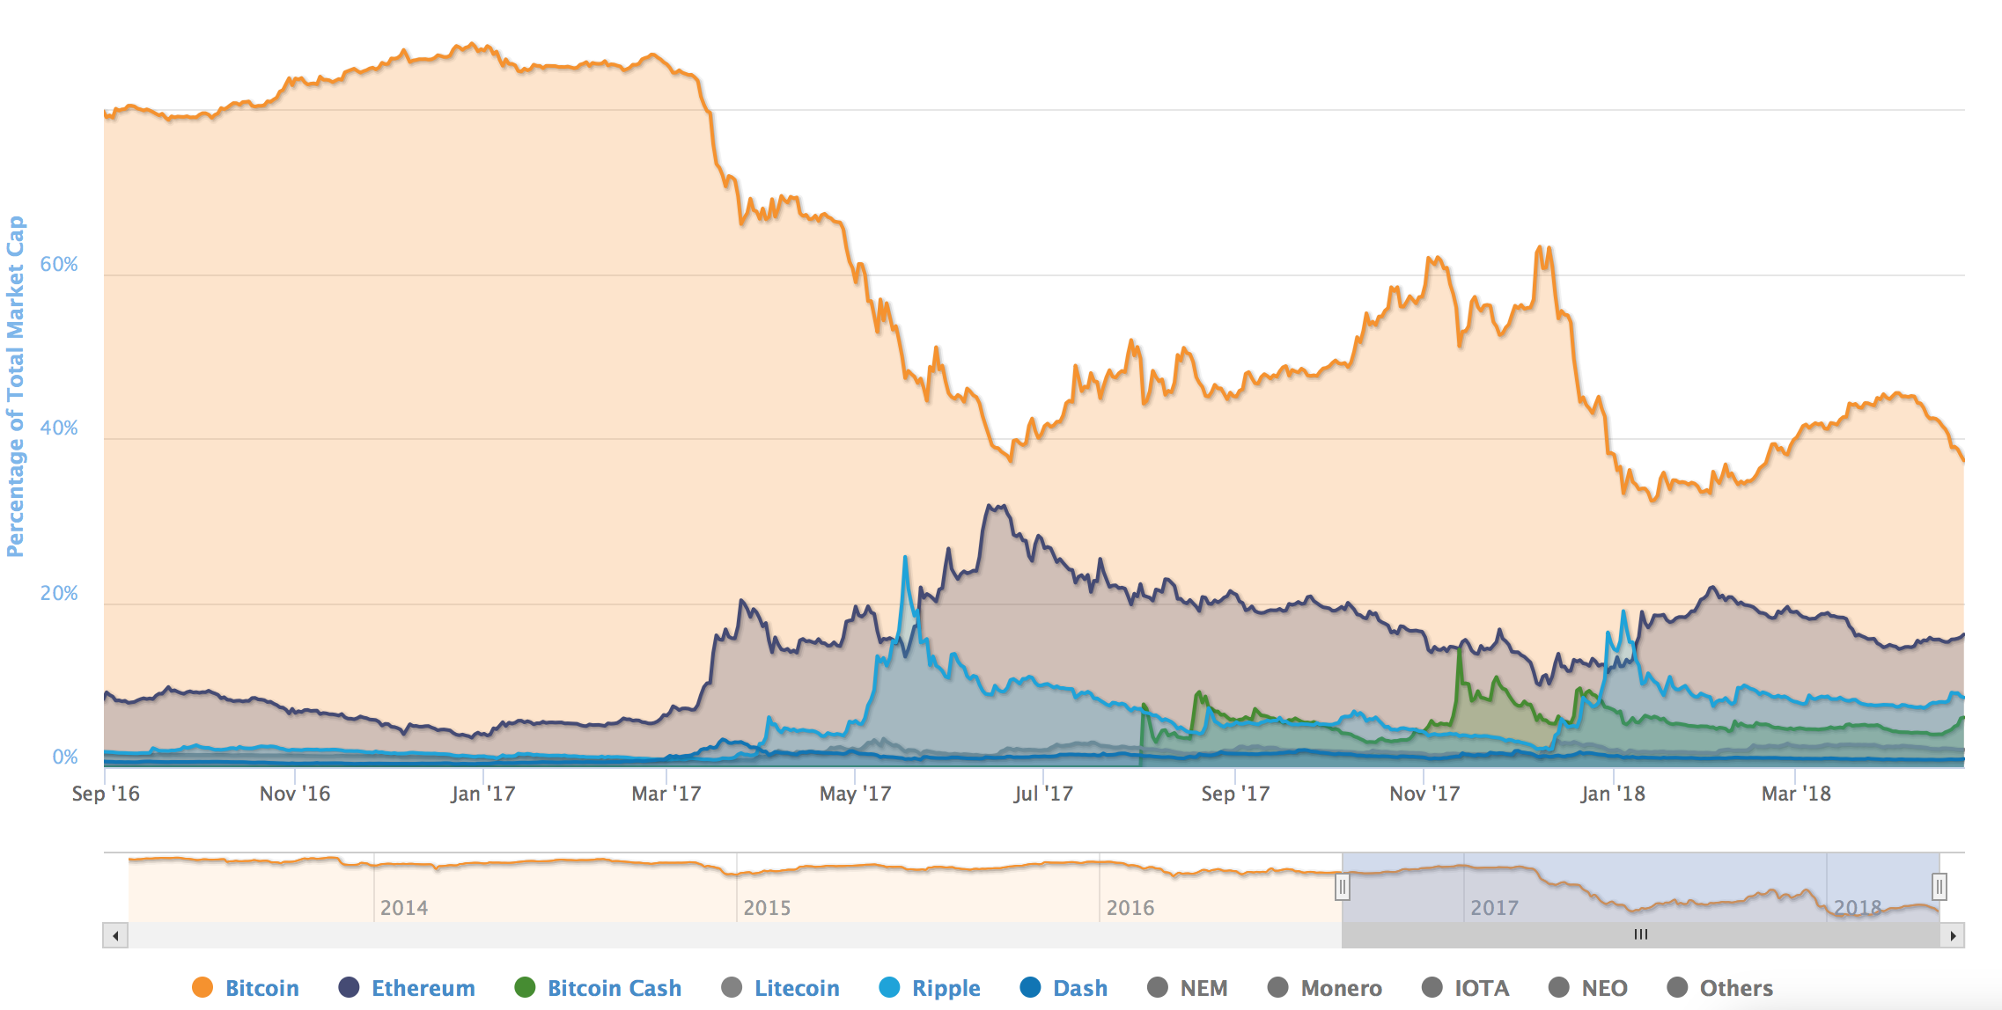
Bitcoin
30%
Notes:
The market is dominated by Bitcoin. However, its market share has declined by 30% as other cryptocurrencies are entering the market.
For this project, we focused on Bitcoin since it is the first and largest in market cap crypto.
From a market standpoint, we wanted to know if Bitcoin can be considered an asset class similar to the world’s government-backed currencies.

Slide 5
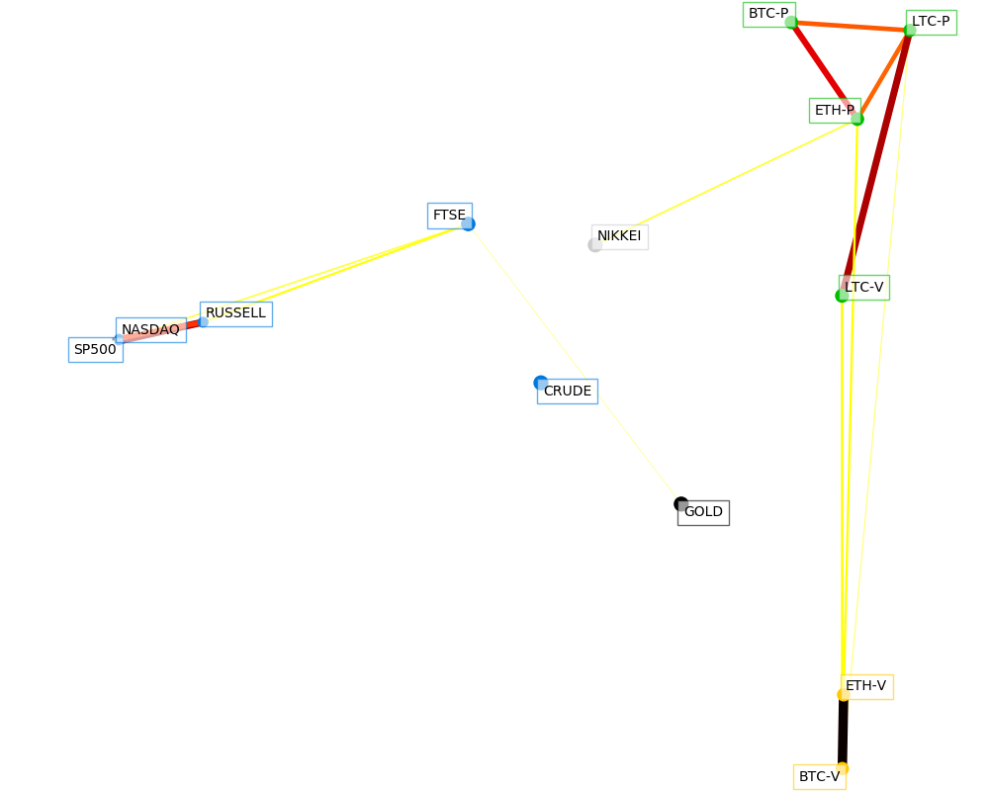
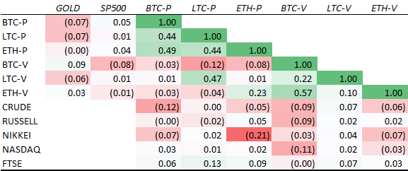
Commodity?
Notes:
We analyzed correlations between Bitcoin and other assets and modeled various foreign exchanges to determine their influence on the price of crypto.
Cryptos are slightly negatively correlated with gold and slightly positively with S&P500.
Investors appear to be utilizing Bitcoin more as an asset to hold value to hedge against other markets.
It is too early to conclude Bitcoin is a store of value.

Slide 6
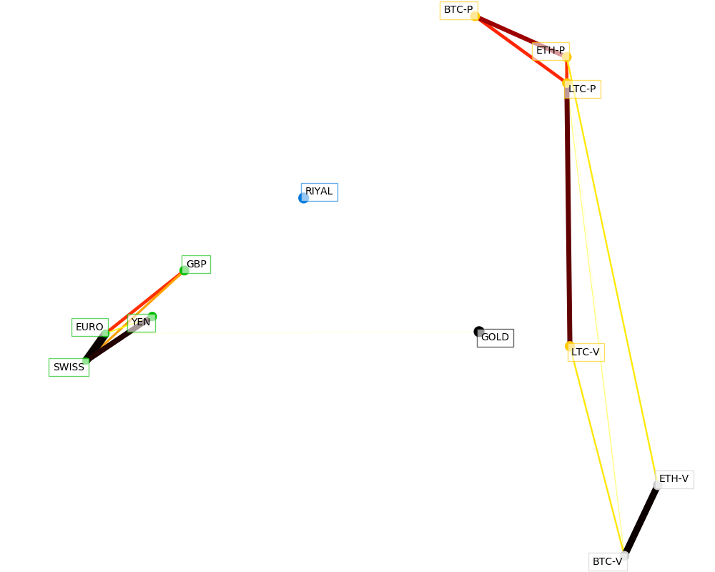
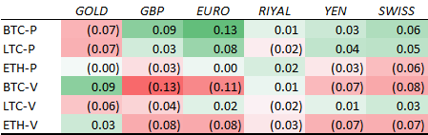
Fiat?
Notes:
Bitcoin and Litecoin are positively correlated with various fiat currencies.
Ethereum is slightly negatively correlated with the same currencies. Ethereum is a smart contract platform while Bitcoin and Litecoin are at this time conventional cryptos.
Market correlations show that crypto may be primed to be an asset class all by itself once it can also be shown that it meets all necessary criteria.

Slide 7
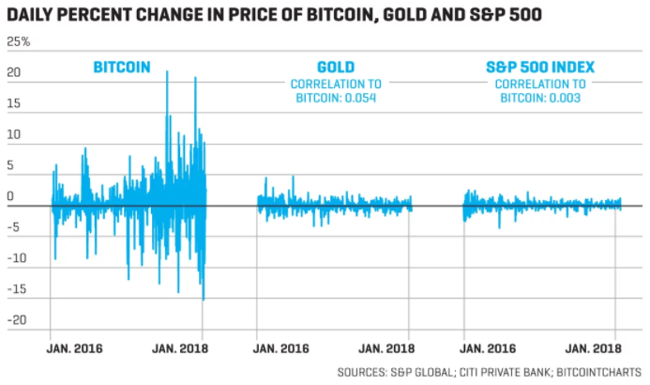
Volatile?
Notes:
As a young asset, it lacks economic fundamentals making it very difficult to predict. Its volatility is far higher than gold and the S&P 500 attracting investors trying to “catch the wave.”
Factors such as regulatory news, investor hype, exchange volatility, large liquidity sell offs can greatly affect the price of Bitcoin.
With recent severe market downturn and now upturn, the market economic indicators that guide investors are undefined.

Slide 8
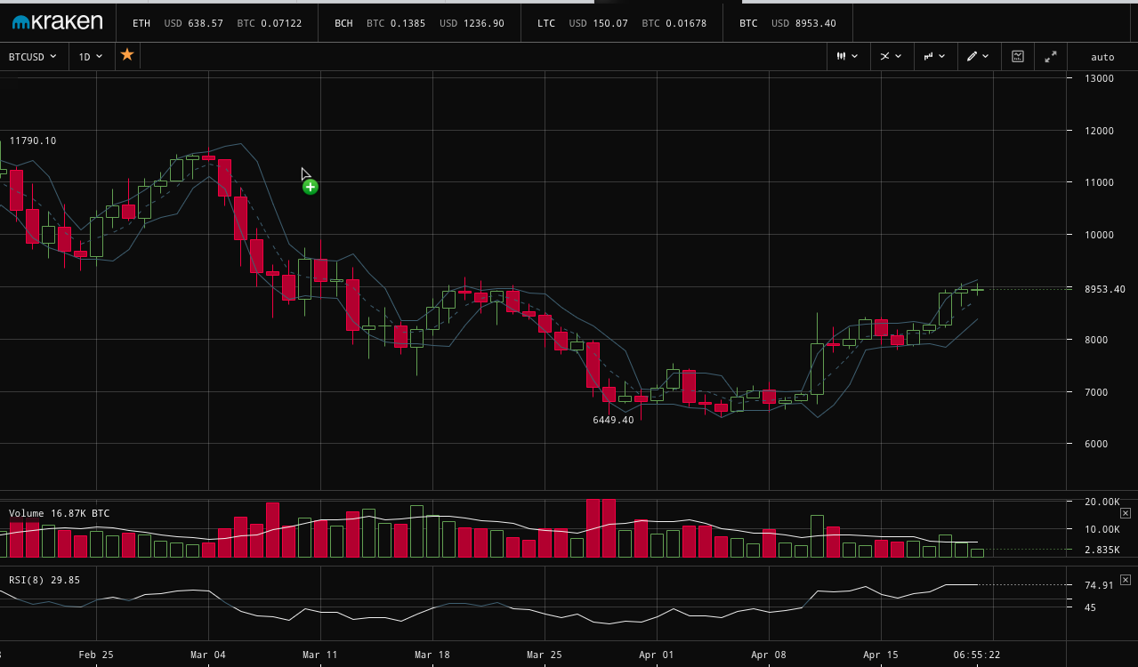
Investing in Crypto
Notes:
How do crypto investors forecast the market today?
Some use traditional market trading charts along with technical indicators to predict the future based on the past.
Some use algorithmic micro trading.
Volatility makes the market very difficult to forecast and difficult for an investor to know when to Buy, Sell or Hold cryptos.

Slide 9
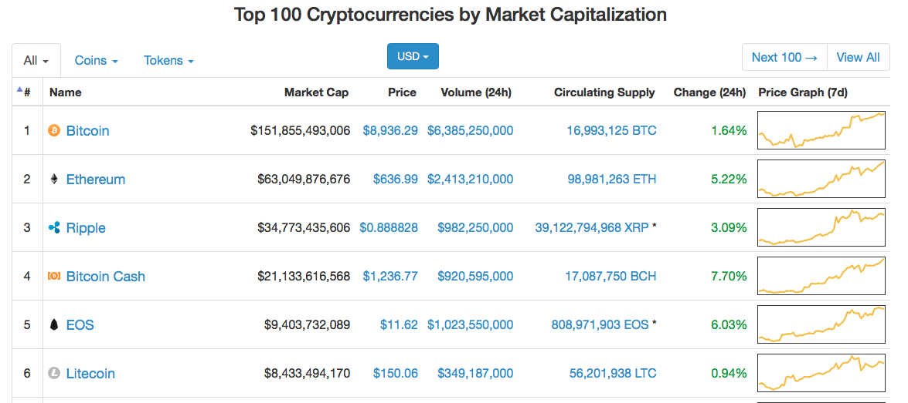



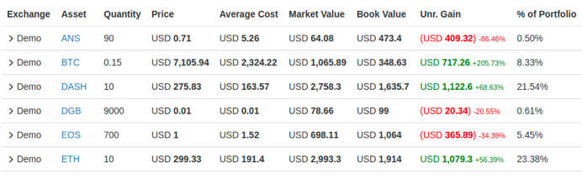
Investment Tools
Notes:
Tools available to investors today include trading chart tools;
Exchange data such as market capitalization, price, 24h volume, supply, price change and price trend.
Social media news on Reddit and Twitter.
Tracking developer stats on Github.
Tracking performance of portfolio.
None of these tools provide a recommendation of a crypto. They provide you data, but you must draw the conclusion.

Slide 10
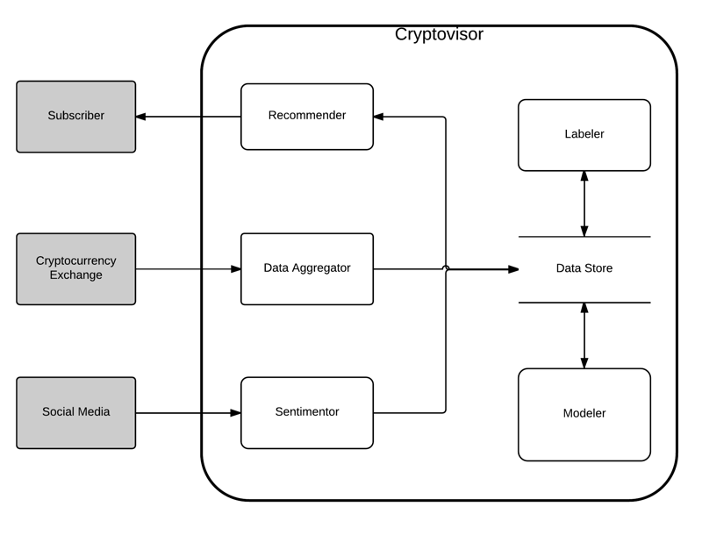
Cryptovisor
Notes:
We propose a recommendation tool that users can subscribe to on their phone for various cryptos and receive alerts when it is a good time to enter or exit the market based on their trading strategy.
The subscriber mobile application would retrieve any alerts for the watched cryptos on a regular time interval. If any were found, the user would be alerted.
The recommender users the modeler to classify a crypto during this time period as a buy, sell or hold trade.
The modeler is trained on labeled data from the labeler.
The labeler labels historical cleaned exchange data based on an algorithm leveraging momentum technical indicators.
In a future iteration, social media data would feed a sentimentor and this data would be leveraged into a modified algorithm.

Slide 11
Cryptovisor
Notes:
We propose a recommendation tool that users can subscribe to on their phone for various cryptos and receive alerts when it is a good time to enter or exit the market based on their trading strategy.
The subscriber mobile application would retrieve any alerts for the watched cryptos on a regular time interval. If any were found, the user would be alerted.
The recommender users the modeler to classify a crypto during this time period as a buy, sell or hold trade.
The modeler is trained on labeled data from the labeler.
The labeler labels historical cleaned exchange data based on an algorithm leveraging momentum technical indicators.
In a future iteration, social media data would feed a sentimentor and this data would be leveraged into a modified algorithm.

Slide 12
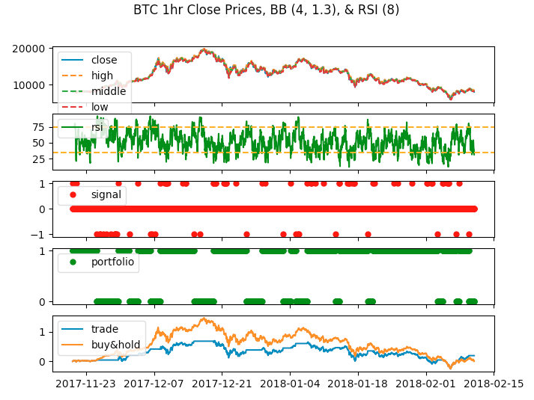
Trading Strategy
Notes:
The initial setup of the algorithm and sanity check of the approach is visually checked and refined.
The top row is the close price and Bollinger Bands.
The second row is the Relative Strength Indicator and upper and lower cutoffs.
The third row is the signal or labels based on the algorithm
The fourth row is the ownership of the crypto.
The fifth row is the performance of our trading strategy against a baseline buy and hold strategy.

Slide 13
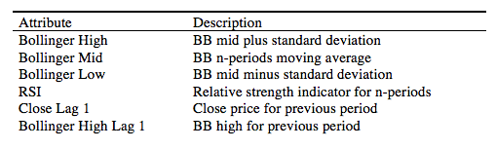
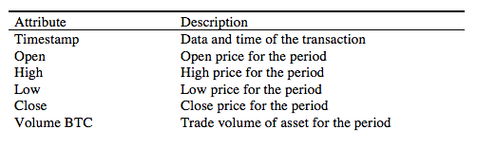
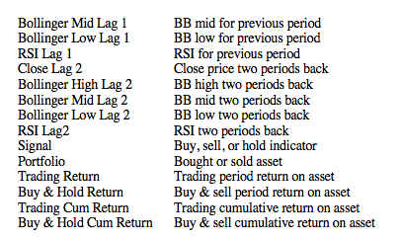
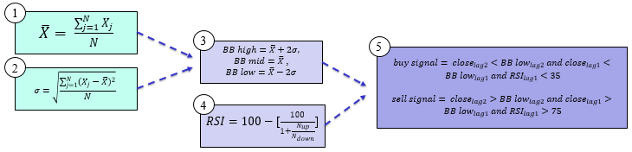
Labeler
Notes:
Our data for this project was Bitcoin historical exchange price hourly data from cryptocompare API, 10/3/2016 to 2/10/2018.
For each time series data point, the moving average (1), standard deviation (2), Bollinger Bands (BB) (3), Relative Strength Indicator (RSI) are created. BB are volatility lines created from a close price moving average and its standard deviation. Relative Strength Indicator (RSI) is a momentum oscillator that measures speed and change of price movements between zero and 100. N is the average days up or down closes. Trading signals are generated followed by the returns and compared with a buy and hold strategy to ensure trading signals yield comparable results.

Slide 14
Labeler
Notes:
Our data for this project was Bitcoin historical exchange price hourly data from cryptocompare API, 10/3/2016 to 2/10/2018.
For each time series data point, the moving average (1), standard deviation (2), Bollinger Bands (BB) (3), Relative Strength Indicator (RSI) are created. BB are volatility lines created from a close price moving average and its standard deviation. Relative Strength Indicator (RSI) is a momentum oscillator that measures speed and change of price movements between zero and 100. N is the average days up or down closes. Trading signals are generated followed by the returns and compared with a buy and hold strategy to ensure trading signals yield comparable results.

Slide 15
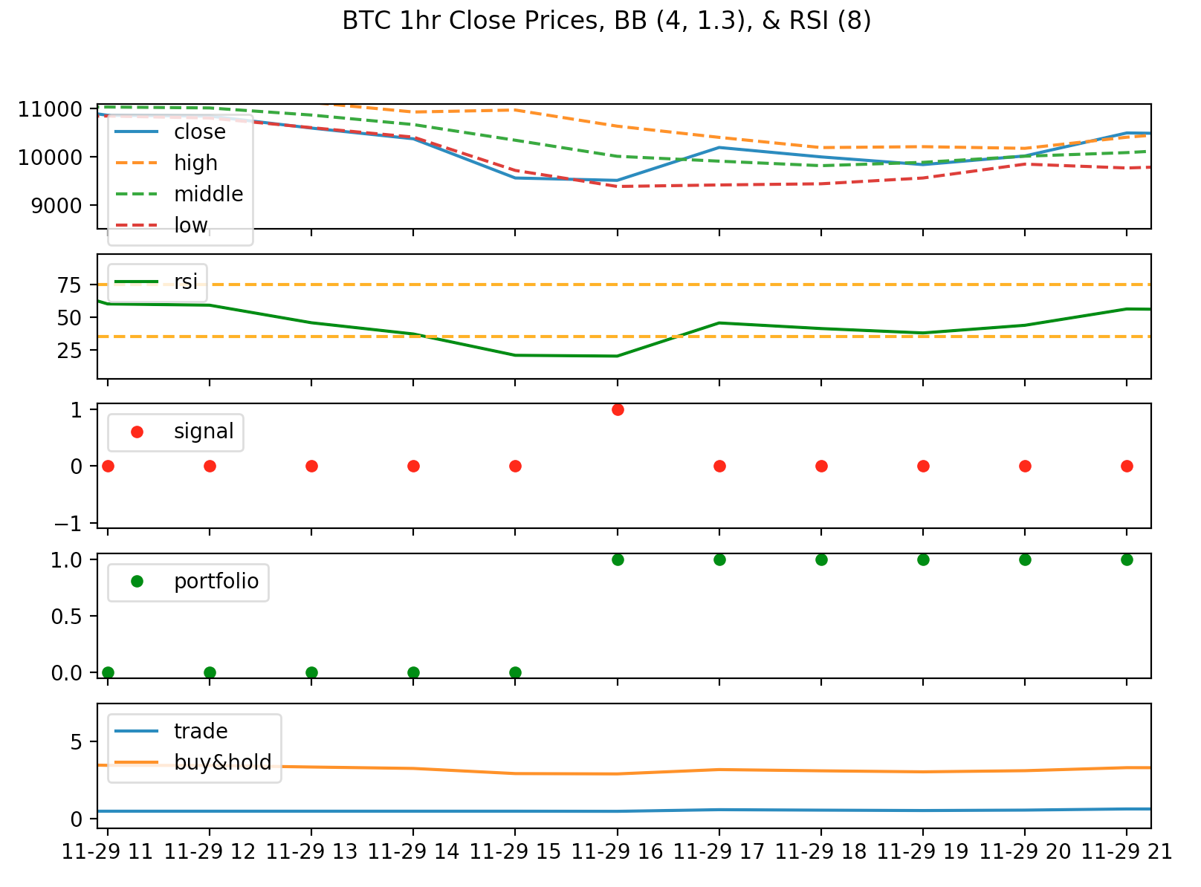
Labeler
Labels
Notes:
In this slide, we are zoomed in to see how the algorithm chose to label a data point as buy.
If the two periods lag close price is less than the lower BB and the previous close price is less than the lower BB and the previous RSI is lower than the cutoff, we should buy the cyprto.

Slide 16
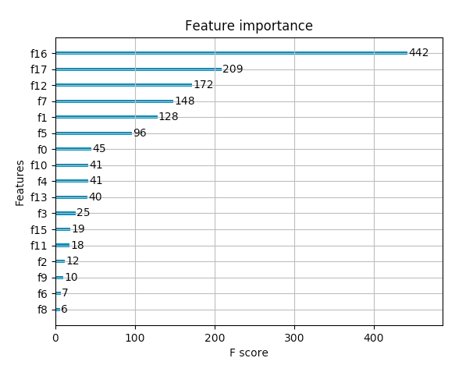
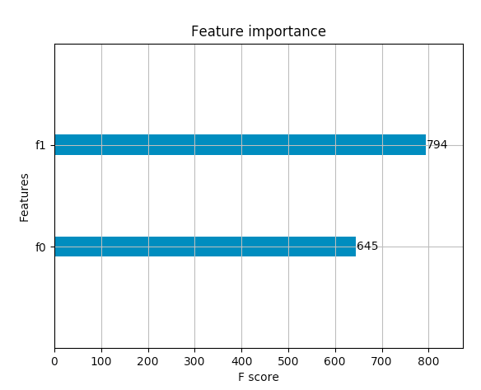
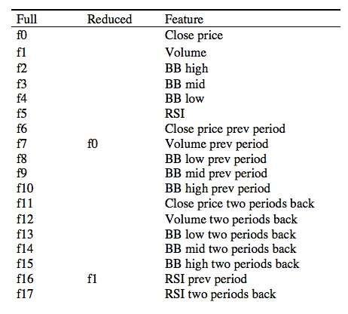
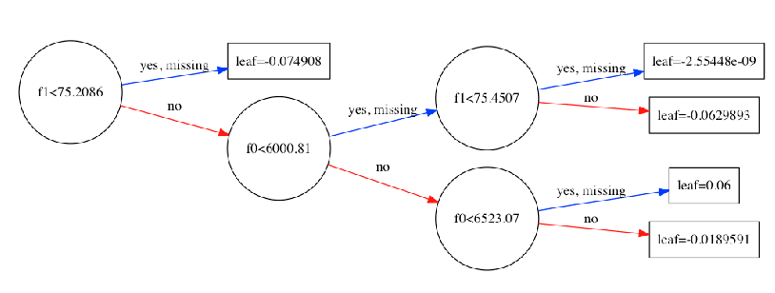
Modeler
Notes:
Now that we have labeled data, train a modeler.
The labeled data is prepared for the modeler.
The prepared data is stratified 10-fold and fed into a XGBoost Stochastic Gradient classifier.
The cross validation score is produced.
The feature importance is analyzed and features are pruned to determine the minimal dataset required to recommend.
For our scenario, we reduced the features from 16 to 2.
The decision tree for the two features is shown in the bottom left.
What is interesting is that the previous volume is a strong predictor and was not used in the labeler algorithm.

Slide 17
Modeler
Notes:
Now that we have labeled data, train a modeler.
The labeled data is prepared for the modeler.
The prepared data is stratified 10-fold and fed into a XGBoost Stochastic Gradient classifier.
The cross validation score is produced.
The feature importance is analyzed and features are pruned to determine the minimal dataset required to recommend.
For our scenario, we reduced the features from 16 to 2.
The decision tree for the two features is shown in the bottom left.
What is interesting is that the previous volume is a strong predictor and was not used in the labeler algorithm.

Slide 18
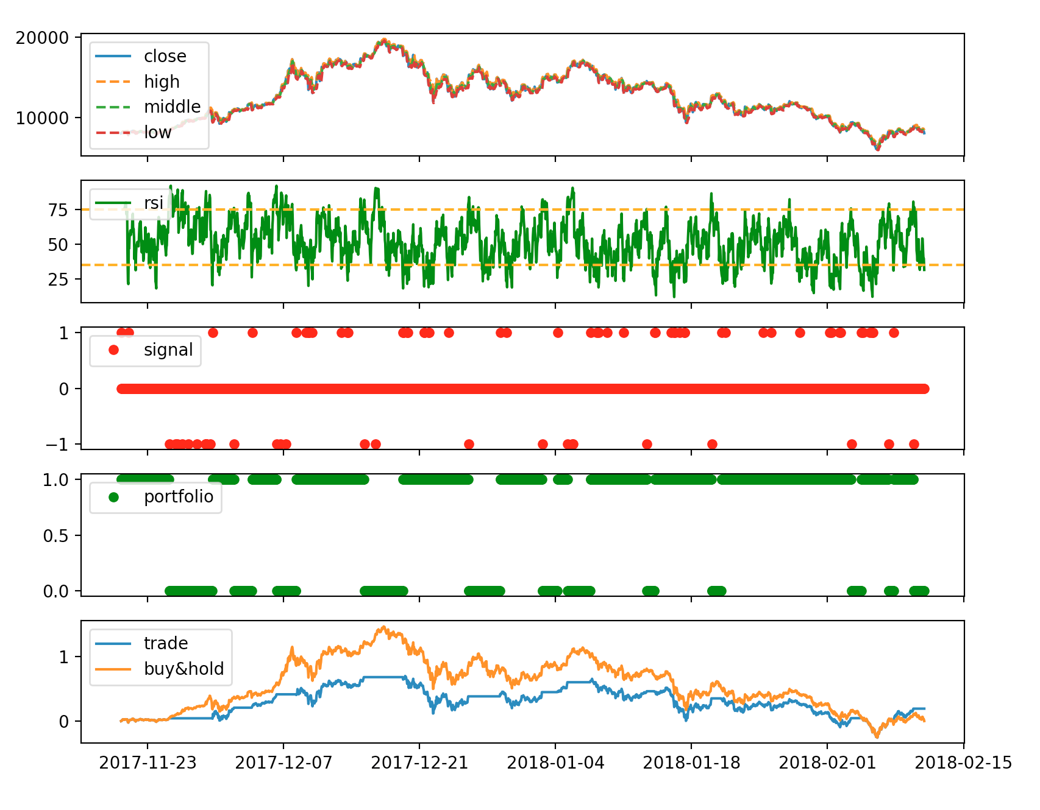
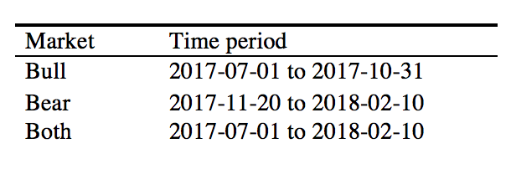
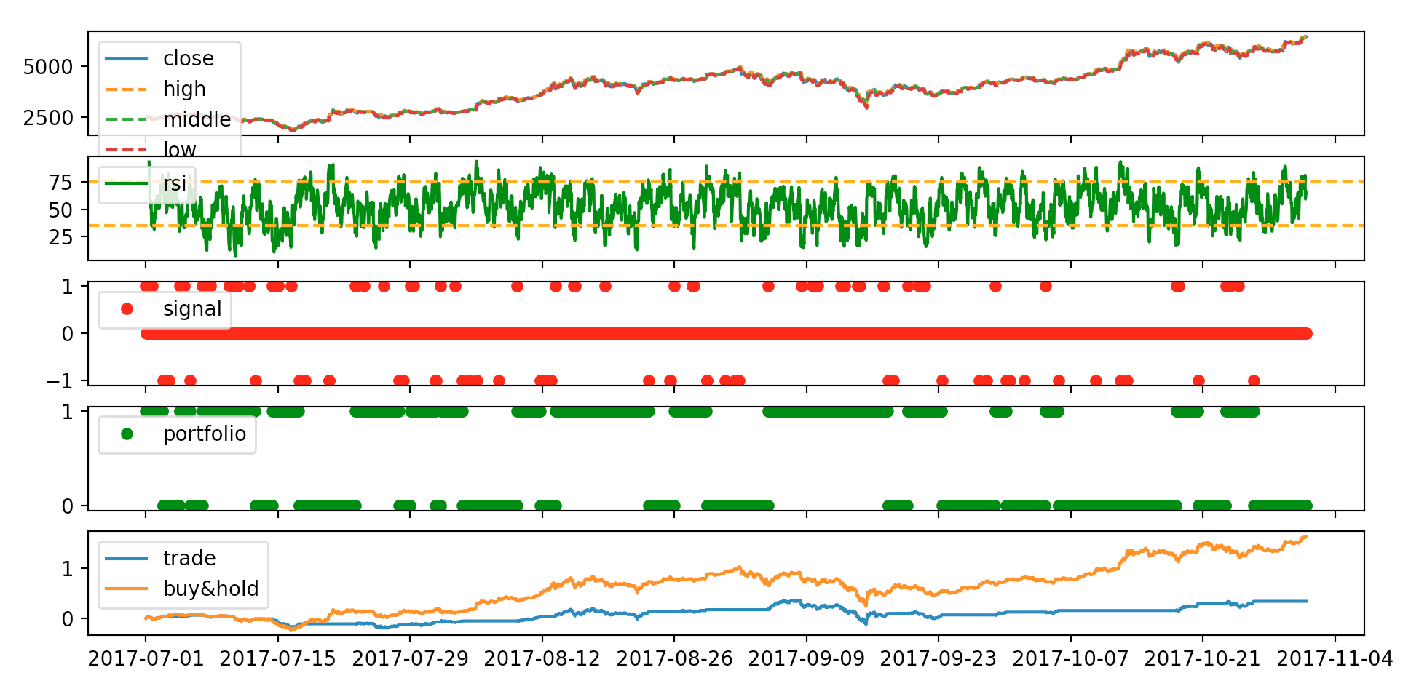
Bear, Bull or Both Markets
Trade/ Market | Bear | Bull | Both
Hold | 1908 (96.1%) | 2850 (96.5%) | 5205 (96.4%)
Buy | 52 (2.6%) | 58 (2.0%) | 118 (2.2%)
Sell | 26 (1.3%) | 44 (1.5%) | 78 (1.4%)
Notes:
A bull market is a period of several months or years which asset prices consistently rise.
A bear market is a period of several months or years which asset prices consistently fall.
Bear, bull, and both markets together were labeled, modeled and analyzed for results.
For each market, we ensured we had minimal labels to trade.

Slide 19
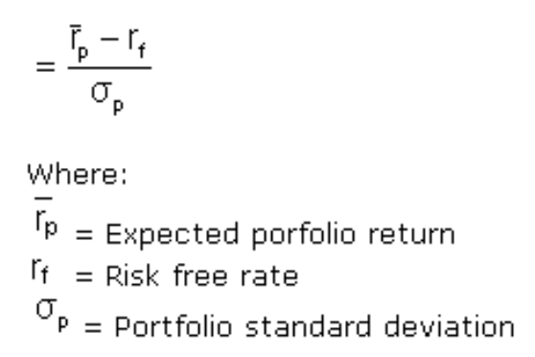
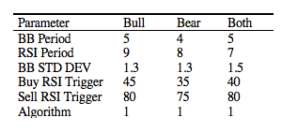
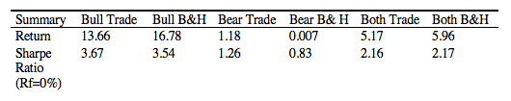
Bear, Bull or Both Markets
Sharpe Ratio
324 scenarios each
From 1928 to 2016, S&P 500 annual Sharpe Ratio < 3
Notes:
For each market, we ran scenarios from a grid of parameters to determine the optimal combination that yielded the best Sharpe Ratio.
Sharpe Ratio is the measure for calculating risk-adjusted return and is the industry standard. It was developed by Nobel laureate William F. Sharpe.
A Sharpe Ratio greater than 1 is considered acceptable to good by investors.
Higher than 2 is rated as very good.
Higher than 3 is considered excellent.
Up until 2016, the S&P500 has never exceeded 3.

Slide 20
Future Work
Other Currencies
Other Technical Indicators
Sampling and Training
Notes:
Analyzing Bitcoin served as a proof of concept that we could effective recommend a trade in cryptocurrency market.
The next step is to apply process to other cryptocurrencies to understand how they behave compared to Bitcoin.
In addition, there are over 90 technical indicators to explore to determine which ones and which combination yield the best results.
Next, modeling three time windows isn’t sufficient. We should explore modeling weekly, monthly and quarterly to see results.
In addition, does an hourly sampled data perform better than a 2hr, 4hr or a day?
After we determine which algorithm, sampling, and time window works best, we would automate the process to see if we agree with the real-time alerts.

Slide 21
Conclusion
Crypto market is young, volatile and risky
It is a new asset class that requires new tools for investors
With 95.5% accuracy and a standard deviation of 0.54%, the Cryptovisor tool can determine if an investor should buy, sell or hold Bitcoin.
Notes:
By leveraging technical momentum indicators to provide buy, sell, and hold markers or labels, a tool can be developed that performs as good or better than a buy and hold trading strategy in a bear market, bull market or both markets.

